Slide 1
ASEM - Avago Drop Shipment Process
FGI Receiving Process
Order Receiving Process
Picking Process
Customer Inner Label Printing Process
Label Verification Process
Packing & Outer label Printing Process
Invoicing & Shipment Booking
Final Lot Ship
Summary Of Project Status
Prepared by Chong Kim Chor (ASEM-IT)

Slide 2
FGI Receiving Process
ASE System
Test Mfg
Shipping Dept
Remark
Lot completed
post test
Put away transaction: Track Out lot from FGST by selecting ASE LotNo, key in seal date & Shelf Loc
Shipping team go to FW system, track out the lot from FGST step.
(ASE Lot No, Shelf Loc and Seal Date)
MES (Factory Works)
Manual Process
Transfer logsheet and Traveler attach together with physical lot send to shipping dept
Receive physical lot
Test Operator fill up transfer logsheet (ASE Lot No, No of Box, Qty)
Base on the Transfer LogSheet, Shipping Dept verify the physical box label vs process traveler.
(ASE Lot No, Trace Code/Cust Lot No, Customer Device and Qty)
Shipping team put away the lot into warehouse. Write down Shelf loc and Seal Date on the transfer logsheet.
Verify transfer logsheet, inner box label and Traveler manually
Store physical lot into warehouse
SAP
After track out the lot from FGST, lot details updated to SAP (real time). Lot trigger billing process.
Lot details updated in SAP
Logistic & Invoicing System (LI)
Lot details updated in LI System
LI system pull Lot details from SAP system every half and hour.

Slide 3
Customer Order Receiving Process - Flow
System
Customer
IT
Shipping Dept
Remark
Customer send Pick Slip file in Pdf format by email
Customer System
Avago will send pick slip file to ASEM shipping team by email. A copy of pick slip file in .dat file format will upload to Avago ftp server.
Avago to advise the time when the file will be uploaded.
DDL - Dat pickslip file will be posted to Avago FTP server
Schedule job to pull the pickslip .dat file from Avago ftp on fixed time.
A schedule job will download the pickslip .dat file from Avago ftp server. Data will be loaded into ASEM LI System. Based on the customer lot number in the pick slip file, system will matched to ASEM internal PT number, FGI Shelf location to create internal ship request file.
Ship Request file will be sent to shipping team by email.
Logistic & Invoicing System
(LI)
Print out Internal Ship Request File
Load data from the file to LI System, generate internal ship request file in pdf format, send to shipping team by email
Login to LI, assign invoice no for each Pickslip ID
Manually write Invoice No in the Ship Request document
Shipping team receive Ship Request file and print out. Go to LI System, assign invoice no to each PickSlip ID. One invoice to one PickSlip ID.
Continue to Picking Process

Slide 4
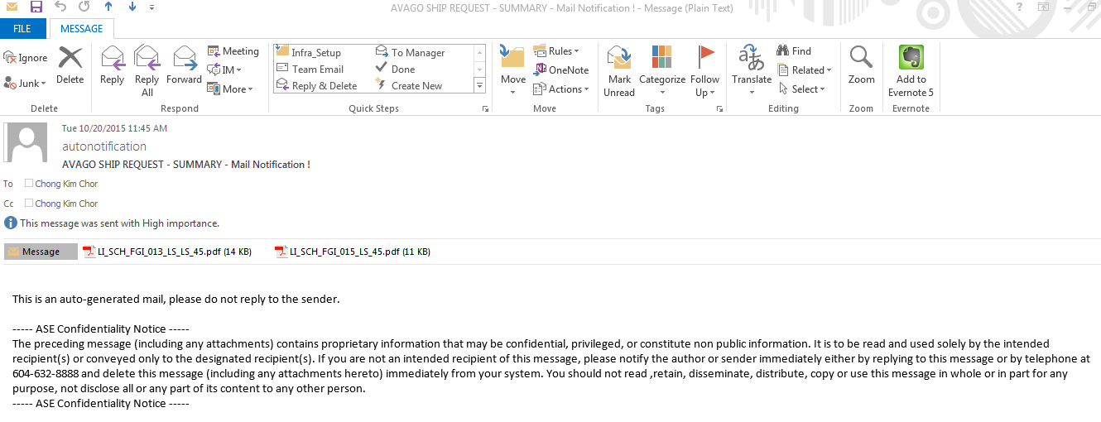
Customer Order Receiving Process – Details 1
Sample PickSlip file (.dat) from customer as below.
The scheduled job will load this file into LI system and generate internal ship request file to shipping team by email.

Slide 5
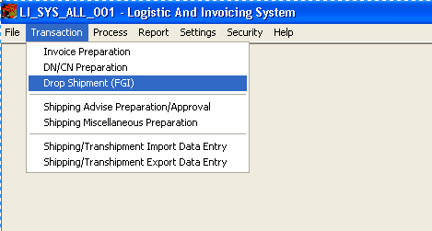
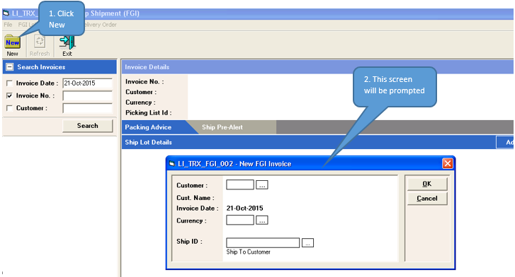
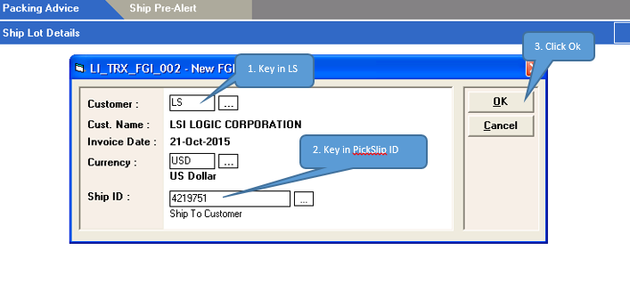
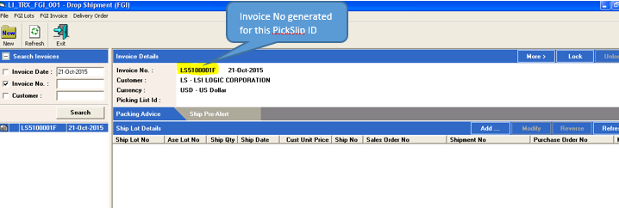
Customer Order Receiving Process – Details 2
Assign Invoice No to each PickSlip ID
Login to LI System. Go to Transaction → Drop Shipment (FGI)
Click New. In the new screen prompt up, key in Avago Customer Code LS.
Scan in the PickSlip No. And Click OK.
Invoice No will be generated.
2
1
4
3

Slide 6
Picking Process
System
Shipping Dept
Remark
Logistic & Invoicing System
(LI)
Refer to physical Ship request document
Based on the ship request document, refer to Shelf location and customer lot number to pick the # of box required into a trolley.
No box splitting is allowed in FGI.
Manual Process
Retrieve lot from warehouse, pick physical lot into trolley
Box Splitting?
Yes
Relabeling & QA buyoff
No
Summary:-
Lot Splitting is possible in FGI where relabeling process is needed.

Slide 7
Customer Inner Box Label Printing Process
System
Fresh Print Flow
Reprint Flow
Remark
Fresh Printing Flow:-
Login to Label Printing System (LPS)
Go to screen – Avago LSI Inner Label Bartender
Scan in the PickSlip number from ship request document. System will list down all ship lot number required.
Scan in ship lot # from ship request document.
Scan in the Inn-Gen 2D barcode stick on the physical box.
If that is the correct 2D barcode scan, user can click the print button to print the customer inner box label.
Login to LPS
Login to LPS
Label Printing System (LPS)
Launch the screen – Avago LSI Inner Label Bartender
Launch the screen – Avago Drop Ship Inner Label (FGI)
Select Reprint
Scan in Pickslip #
Scan in the Pickslip #
Scan in the Ship Lot #
Scan in Ship Lot #
Reprint Flow:-
Login to Label Printing System (LPS)
Go to screen – Avago LSI Inner Label Bartender.
Scan in the PickSlip number from ship request document.
Scan in ship lot # to reprint.
Scan in the Inn-Gen 2D barcode stick on the physical box that need to reprint.
System will prompt a screen to enter user name, password and reason to reprint. Only Authorized user can perform the reprint.
Scan in 2D barcode from Inn Gen label
Scan in 2D barcode from Inn Gen label
Input User ID, password and reason to reprint
Click Print
Authorized user?
Yes
No
Blocked from Printing
Proceed Printing

Slide 8
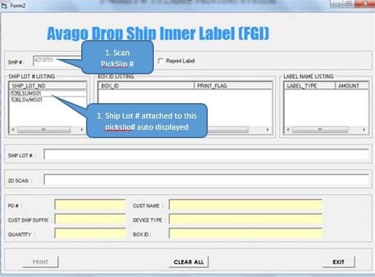
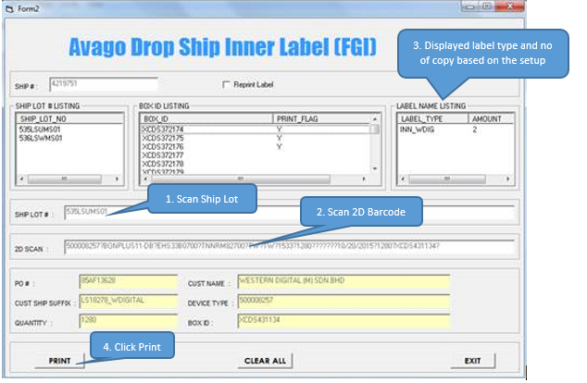
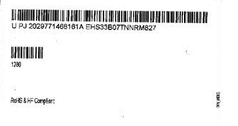
Customer Inner Box Label Printing Process – Details
Login to LPS. Go to Avago Drop Ship Inner label (FGI) screen.
Scan PickSlip #. Ship lot no attached to this pickslip will be auto displayed.
Scan Ship Lot No from internal ship request document.
Scan 2D barcode from inner box (INN-GEN) label. System validate the information on the 2D barcode (Box ID, customer lot no, device and quantity). If matched with system, user can click the print button to proceed printing.
1
2
LS92700_F&R097
Actual Label print out

Slide 9
Label Verification Process
Refer to attached slides for details.

Slide 10
Packing Process – Prepare Packing Instruction
ASEM Current Process
System
Shipping Dept
QA
FGI Outbound Matching System (FOMS)
Prepare Packing Instruction
Shipping team prepare Packing Instruction in FOMS system. Scan in PickSlip #, assign Ship Lot No into every outer box no.
Print out Packing Advice from FOMS.
Scan Ship Req ID, invoice # auto pull. Assign Ship Lot No into outer box in the Packing Advice
Print out Packing Advice Document
Pack Scan screen – Scan in Ship Req ID, Scan every inner box 2D barcode.
QA go to Pack Scan screen – Scan in PickSlip#, and scan 2D barcode from INN-GEN label.
System validate box id, device and qty for every inner box scanned.
Until all inner boxes scanned and the total qty matched, QA key in their password to complete the scanning and print out ship request label.
Label Printing System (LPS)
System matched box id and qty of every inner box.
Until all inner boxes scanned and qty matched, QA key in the user name and password to print out the ship request label
Stick ship request label on outer box

Slide 11
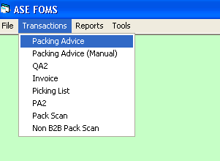
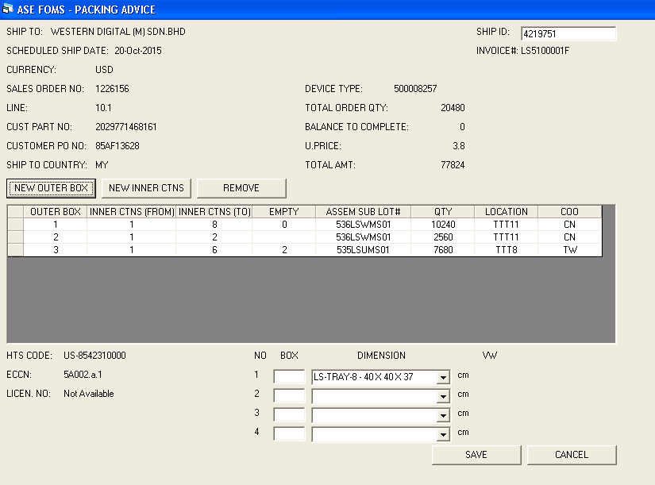
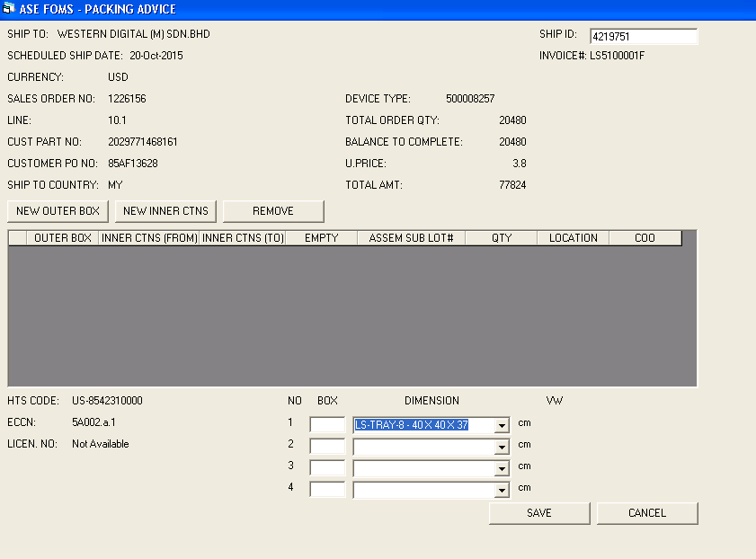
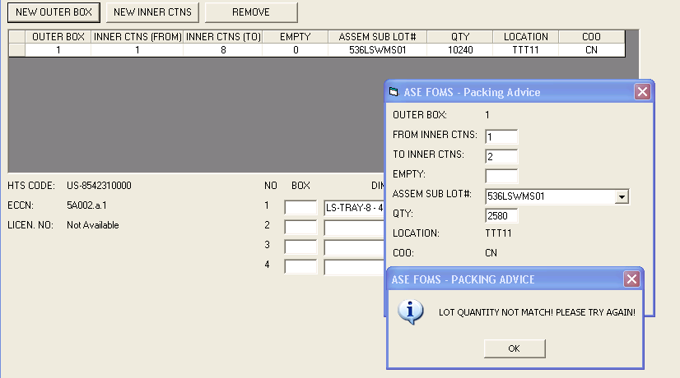
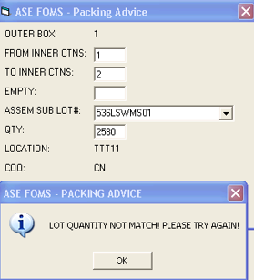
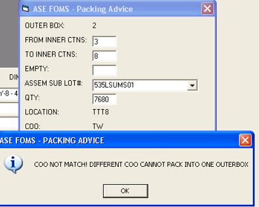
Packing Process – Prepare Packing Instruction Details
Create Packing Advice
Login to FOMS. Go to Transactions → Packing Advice
Scan in Ship ID & press enter. All information auto pulled. Select Outer box dimension.
Click New Outer Box to assign ship lot no into outer box.
Click Save to print packing advice once all inner boxes assigned to outer box.
1
4
2
System checking if quantity assigned not matched with PickSlip order. And different COO cannot be packed into one outer box.
3

Slide 12
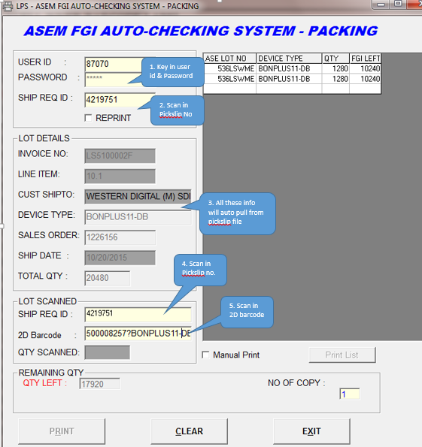
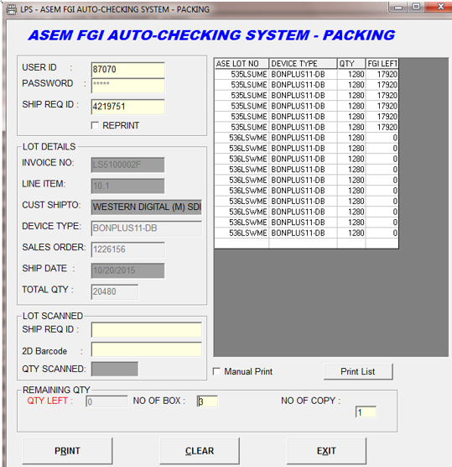
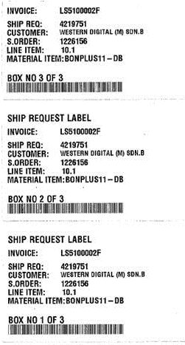
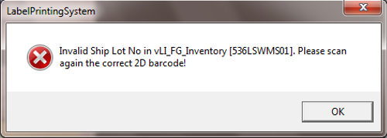
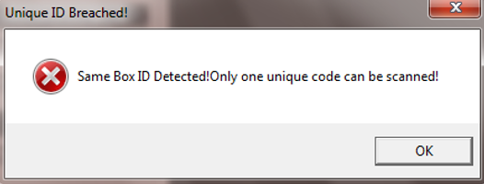
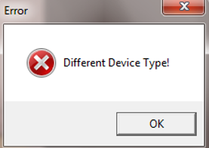
Packing Process – Pack Scan
ASEM FGI Auto-Checking System - Packing
Login to LPS. Go to Menu QA Legerity Barcode Label screen.
Key in user id and password, scan in PickSlip no & press enter. Info on the screen will be pulled from PickSlip file.
Scan ship lot no and inner box 2D barcode on the screen. System will validate if the correct 2D barcode scan Vs Inn-Gen label and PickSlip file. Ship Lot No, Qty and Device Type will be validate. If not matched, user will not able to proceed and required to re-scan again.
Once all inner boxes scanned, user can proceed to print the ship req label.
5. Total 3 outer box ship req label will be printed for this Pickslip no.
4
1
2
Error message prompted on ship lot no, Box id and Device type validation.
3

Slide 13
Packing Process – Outer Box Labeling & Packing
System
Shipping Dept & QA
Remark
Go to LPS, launch Avago Outer box label screen
Shipping team pack the inner box into outer box based on the packing advice,
Scan the invoice number into LPS screen, Print first outer box. QA scan the 2D barcode on the screen, system validate the correct inner box. Shipping team weight the net weight of the inner box and record in the packing advice.
Load the inner box into outer box. Continue with second inner box until all completed. Only when all the required boxes/qty scanned, user can click the print button to print out the outer box.
System will print out the correct labels based on the setup by ship to customer code.
Shipping team Weight the gross weight and stick the labels on the outer box & seal the outer box.
Continue to next box until all complete.
Scan 2D barcode from Inn-Gen label
Scan in the Invoice number from ship req label
Is correct
inner box scan?
No
Label Printing System (LPS) & Packing
Yes
Print 1st outer box
Load the inner box into outer box
Weight inner box
No
Are all the inner
boxes scan?
Yes
Continue to next inner box
Print outer box label & Weight Gross Weight
Stick outer box label & Seal the box
Yes
Next Outer Box?
No
Select next outer box
End Printing

Slide 14
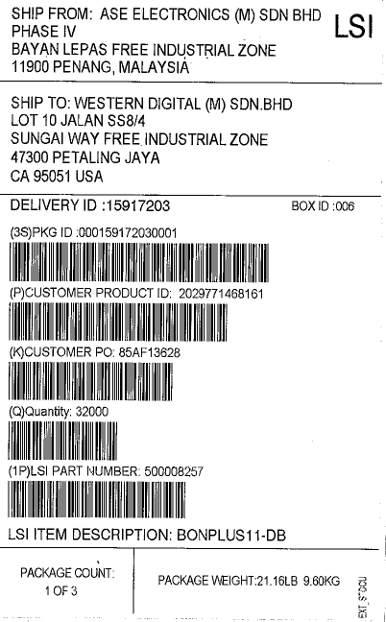
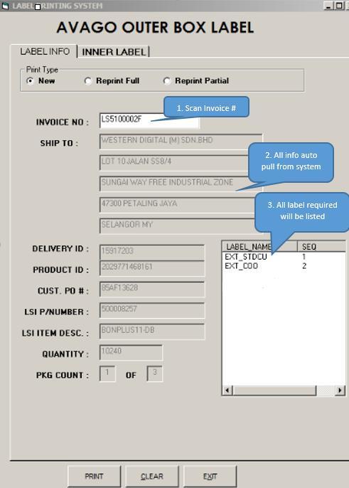
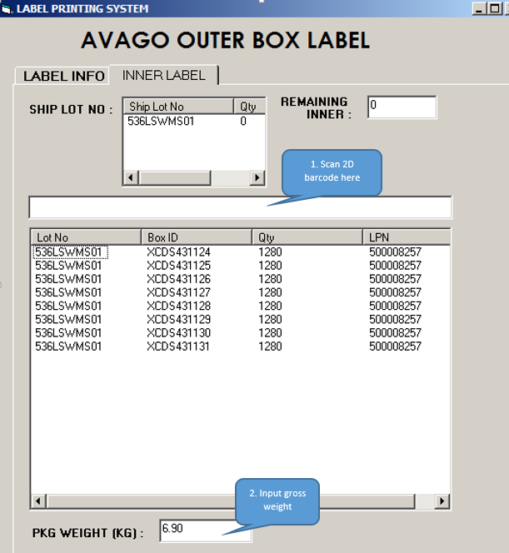
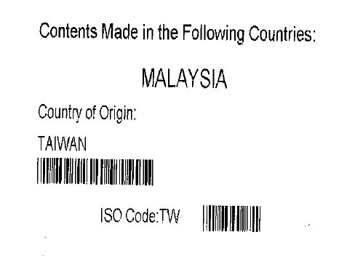
Packing Process – Outer Box Labeling & Packing
Login to LPS. Go to Avago Outer Box Label screen.
Scan Invoice#. All required info auto pulled from system.
Scan all 2D barcode from Inner box label. System validate if the correct inner box scanned. If matched, user continue to scan next box until all scanned. Shipping team load the inner box into outer box.
Weight the outer box gross weight, input gross weight into LPS screen. And click print to print the outer box label.
Stick the outer box label and seal the box. Continue to next outer box until all complete.
Actual Label print out
1
2

Slide 15
Invoicing Process
System
Shipping Dept
Remark
Scan in invoice no from packing advice.
Assign Ship Lot No into the invoice by scan in every ship Lot No. LI System will cross check with FOMS system to ensure the correct ASE Lot No & Qty are scanned.
Key in # of outer box, pack qty for every inner box, net & gross weight into LI system.
Go to Pre-Ship Alert screen, ensure all FGI Term and Packing information are populated (Pick Slip File & FOMS).
Print out Invoice and Packing List from LI System.
Fold Invoice & Packing List into the shipping pouch to be place on the outer box.
Logistic & Inventory System (LI)
Add Ship Lot No into the Invoice. System cross check with FOMS to ensure the correct Ship Lot No scan into the invoice
Scan Invoice No from packing advice
Key in # of outbox, Pack qty for every inner box, net & gross Weight into LI system
Go to Pre-Ship Alert screen to ensure all FGI term and packing information are populated to LI System
Print out Invoice & Packing List from LI system
Fold Invoice & Packing List into Shipping Pouch

Slide 16
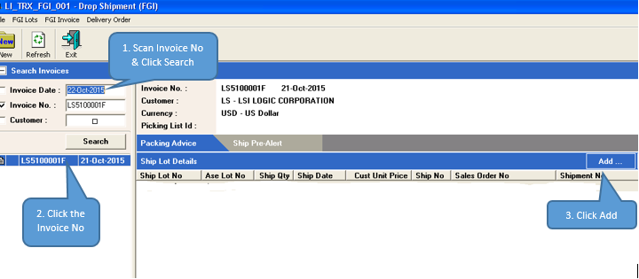
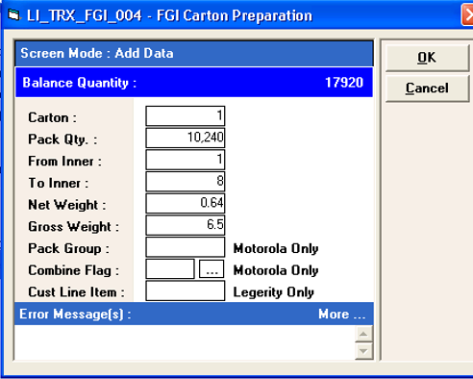
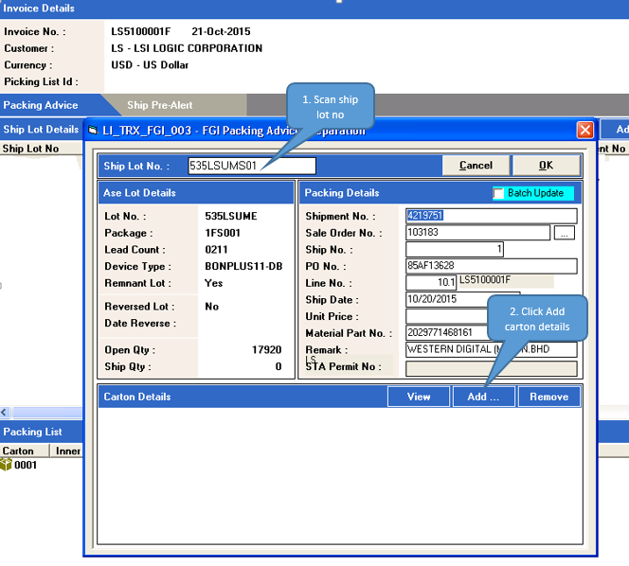
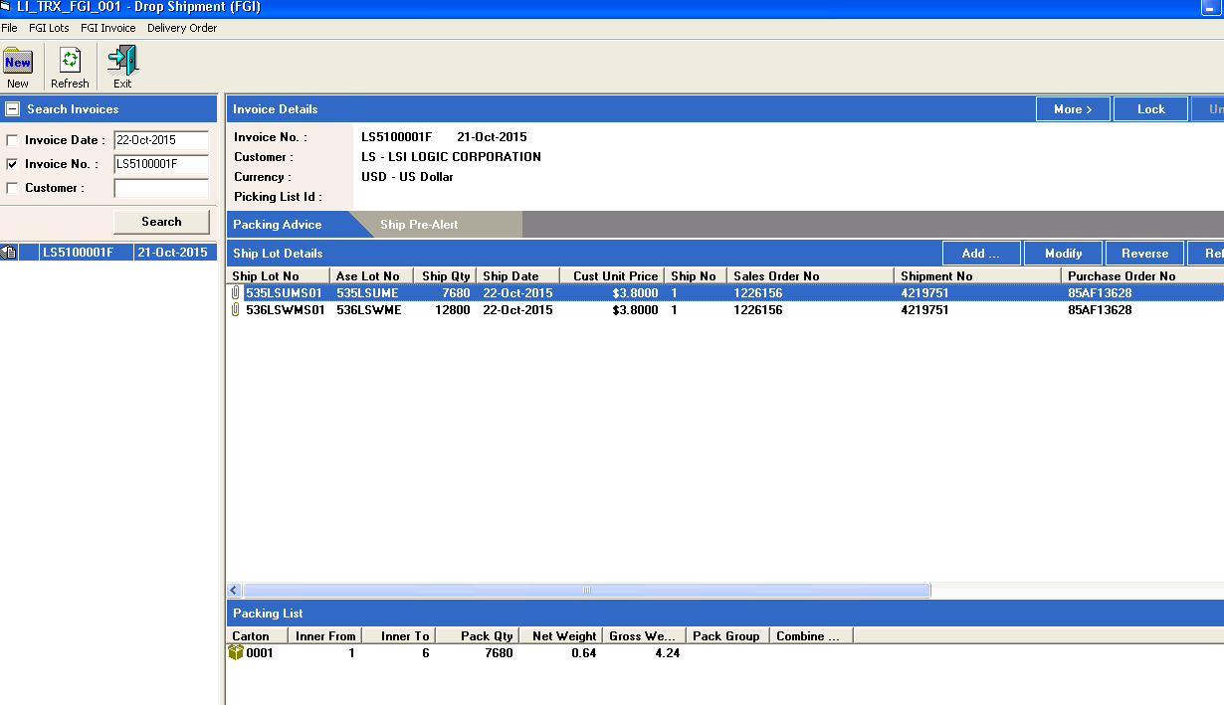
Invoicing Process – Packing Advice
Login to LI System, go to Transaction → Drop Shipment (FGI). Key in Invoice No, and click Search. Select the Invoice No and click Add.
Scan ship lot no and click add to add carton details. Add all cartons details for this pickslip no into system.
All cartons information added to this invoice.
1
2-2
2-1
3

Slide 17
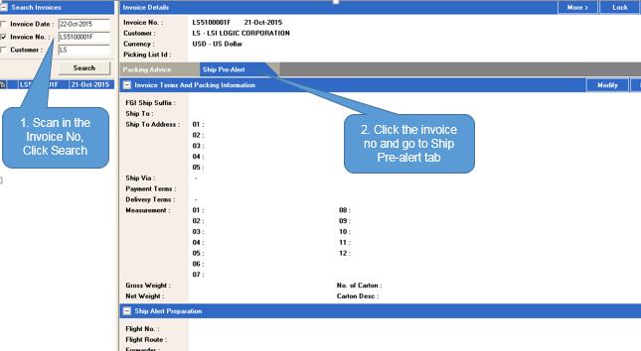
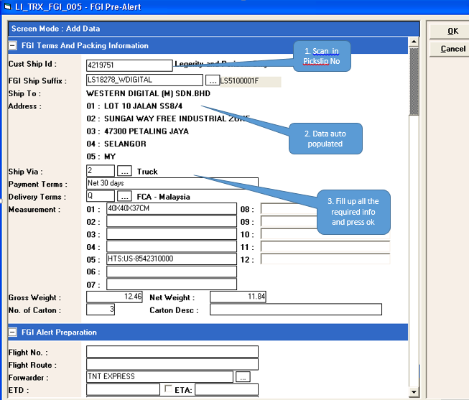
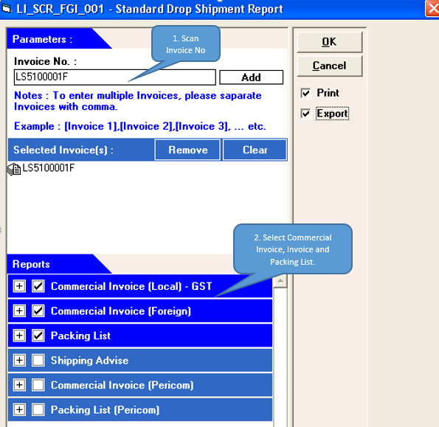
Invoicing Process – Ship Pre-Alert
Login to LI System, go to Transaction → Drop Shipment (FGI). Key in Invoice No, and click Search. Select the Invoice No and click Ship Pre-Alert tab.
Click on Modify button, scan in Pickslip No and press enter. Fill up all the required info and press ok.
Go to Report → FGI Report → Standard Drop Shipment Report to generate Commercial Invoice, Invoice and Packing List.
1
2
3

Slide 18
Shipment Booking
System
Shipping Dept
Remark
Scan in all the invoice number to ship.
System generate the delivery order #.
Print Delivery order and shipment booking document to perform shipment booking with forwarder.
Delivery Order Preparation
Scan all invoices into LI – FGI Delivery Order preparation screen
Logistic & Inventory System (LI)
System generate the Delivery order #
Print out Delivery order and shipment booking document
Proceed to do shipment booking with forwarder

Slide 19
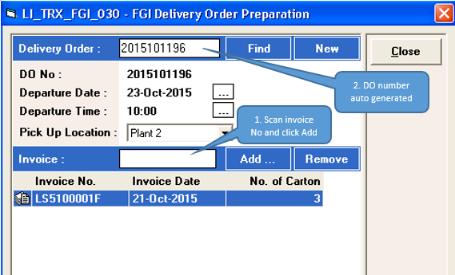
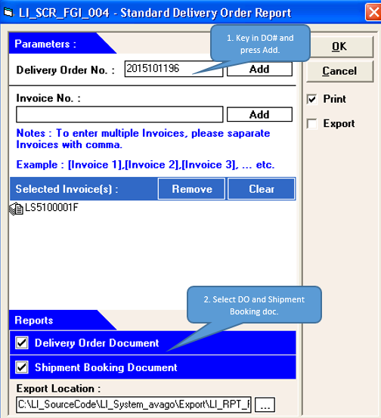
Shipment Booking - Details
Login to LI System, go to Transaction → Drop Shipment → Delivery Order. Scan Invoice No and click Add. System auto create DO #.
Go to Report → FGI Report → Standard DO/Shipment Booking Report.
Key in DO number.
Print Delivery Order and Shipment Booking Document.
1
2

Slide 20
Final Lot Ship Process
System
Shipping Dept
Auto Process
Remark
Go to LI system
Scan in Invoice No from Packing Advice
Shipping team login to LI system, scan in the invoice no from packing advice. All info auto populated.
Go to Pre-ship alert screen, select the shipment method (air/sea/others), select forwarder and check the ETA to ship the lot.
Goods are ready to pick up by forwarder.
Logistic and Invoicing System (LI)
Go to Pre-ship Alert screen
Select shipment method, forwarder, check the ETA and ship the lot
Goods ready to be picked up by forwarder
Various Systems (SAP, FW, FOMS, PT)
Shipment data interface to various internal systems
Once the shipment done, the shipment information from LI system will transfer back to various internal system like SAP, FW.
Logistic and Invoicing System (LI)
Trigger Ship Confirm File to Customer on fixed schedule time
Upon lot shipment, ship confirm file will be sent to Customer FTP server.

Slide 21
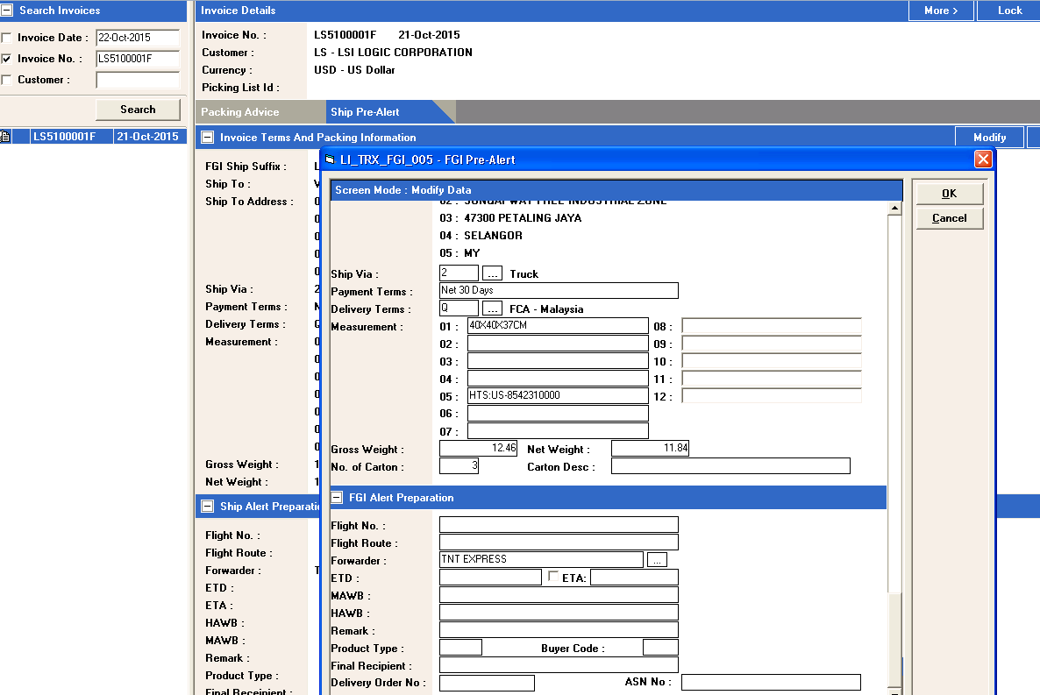
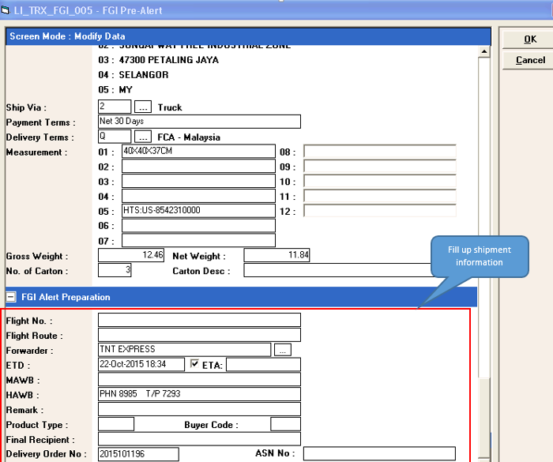
Final Lot Ship Process - Details
Login to LI System, go to Transaction → Drop Shipment → Scan Invoice No and click Search. Select the invoice no.
Go to Ship Pre-Alert tab, and click Modify.
Fill up shipping information and ETD date.
Click ok to confirm the shipment already picked up by forwarder.
1
2
Sample of Ship Confirm file as below:

Slide 22
Summary of Drop Ship Progress
Process | Remarks | Owner | Status
FGI Receiving | Scanning of customer lot id and LPN number will be done in Picking and Packing process. | ASEM | Current Practice
Customer Order Receiving | Receive Pick Slip file from Avago, generate internal ship request file for shipment team to proceed with picking process. | ASEM | Done Development & Buy-off
Picking | Shipment team refer to internal ship request document to perform picking. No system transaction is required. | ASEM | Done & Buy-off
Customer Inner Box Label Printing | New GUI screen to print customer label. Shipment team required to scan 2D barcode on INN_GEN1 label to verify the correct box is picked. Customer label will be printed if verification passed. Shipment team stick the customer label on MBB bag and Inner box before proceed to scan next box | ASEM | Done Development & Buy-off
Label Verification Scanning | QA to scan INN_GEN1 label vs Customer label on MBB bag and Inner box to ensure no swap label and barcode on the label is able to scan. | ASEM | Under development (16-Nov-15)
Packing | Shipping team to generate packing instruction and print ship request label. System to ensure every box is scanned by QA before user can print the ship request label. This is to ensure QA have done 100% scanning before proceed to packing. | ASEM | Done Development & Buy-off
Outer box label printing & packing | QA to scan every inner box INN_GEN1 2D barcode to ensure the correct inner box before load into the outer box. One outer box at a time. Shipping team weight the total net weight and outer gross weight before print outer box labels. Shipping team stick the outer box label and seal the box before proceed to next outer box. | ASEM | Done Development & Buy-off
Final Lot Ship | Shipping team generate shipping documents from system (Commercial Invoice, Invoice and Packing List). QA to buy-off the outer box label and shipping document before proceed to actual lot shipment. | ASEM | Done Development & Buy-off
Ship Confirm B2B File | Upon Lot shipment, ASEM to send Ship confirm B2B file to Avago FTP server. | ASEM/Avago | Done Development & Pending Buy-off

